Slide 1
Dorothy Parker
Introduction to English Literature 04
May 7, 2025

Slide 2
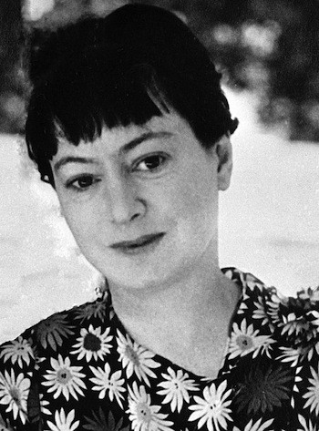
Dorothy Parker Biography
Poet, critic and short-story writer(1893-1967)
Marrying Edwin Parker(1917)
Drama critics in Vanity Fair(1918)
The Queen of ‘Algonquin Round Table’
Published in Cosmopolitan, Harper, and New Yorker after her dismissal from Vanity Fair
Divorced from Edwin(1928) but continued to be called “Mrs Parker”.

Slide 3
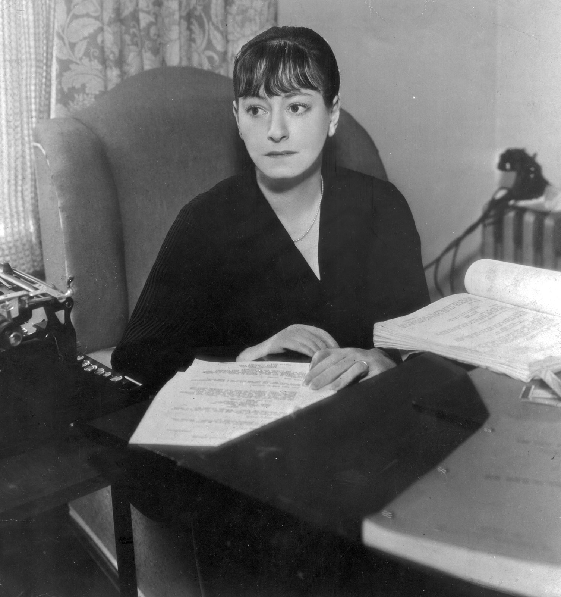
Dorothy Parker Biography
Two suicide attempts after divorce
“Resume”
  Razors pain you; Rivers are damp
  Acids stain you; And drugs cause cramp
  Guns aren't lawful; Nooses give(allow a person or thing to have or to take)
  Gas smells awful; You might as well live.

Slide 4
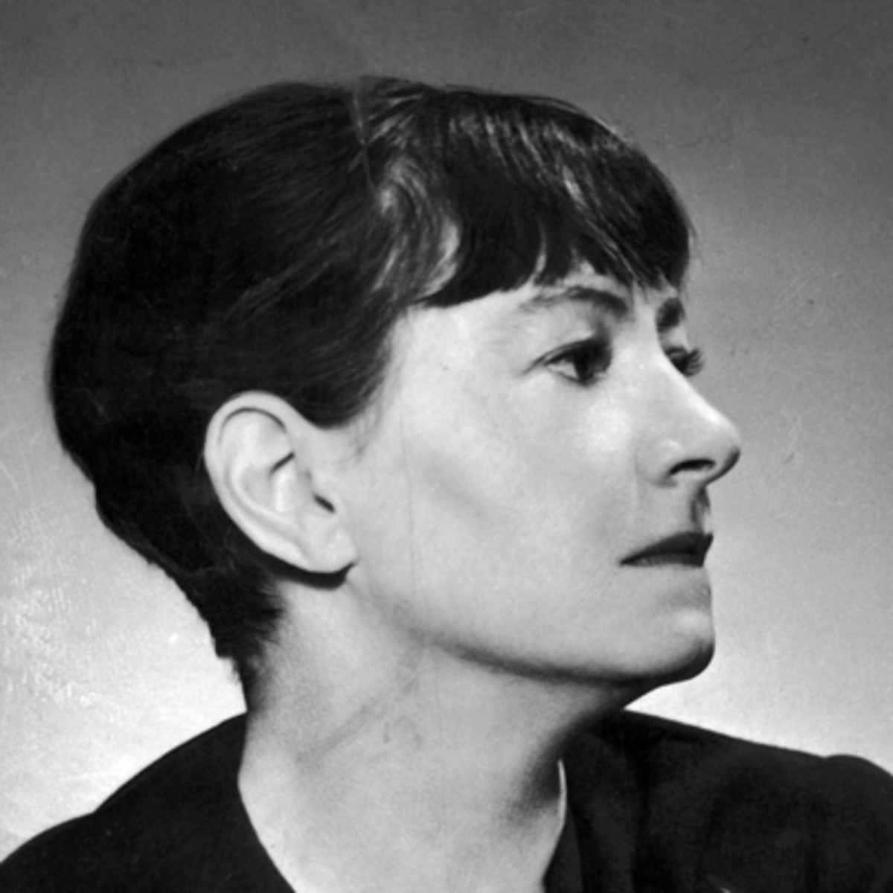
Dorothy Parker Biography
Her poetry’s unique combination of formal simplicity and dark sentiment.
Won the O. E. Henry prize for short fiction.
Marrying a young actor Alan Campbell and moved to California.
Working as a script development team
The Screen Writers Guild and campaigning for civil rights in the 1930s

Slide 5
Dorothy Parker Biography
Wrote the scripts of “A Star is Born”(1937) and Hitchcock’s “Saboteur”(1941).
Went to Spain to report on the Civil war(1937)
Became a staunch enemy to European fascism and a founder member of the Hollywood Anti-Nazi League.
Blacklisted as the ‘Queen of the communists by the MaCarthyists during 1950s.
Continuing commitment to civil rights leaving her estate to Martin Luther King.

Slide 6
A Certain Lady
Oh, I can smile for you, and tilt my head,
And drink your rushing words with eager lips,
And paint my mouth for you a fragrant red,
And trace your brows with tutored finger-tips.
When you rehearse your list of loves to me,
Oh, I can laugh and marvel, rapturous-eyed.
오, 당신을 위해 웃을 수 있어요. 고개를 끄덕일 수도 있죠.
그리고 당신이 쏟아내는 말들을 갈망하는 입술로 들이킬 수 있어요.
그리고 당신을 위해 향기로운 붉은 립스틱으로 입가를 바를 수도 있어요.
그리고 당신이 사랑하는 것들을 나에게 줄줄이 읊어 댈 때면
나의 손끝은 학습된 대로 당신의 이마를 쓸어 내릴 수 있고,
매혹된 눈빛으로 놀라며 웃을 수도 있죠.

Slide 7
A Certain Lady
And you laugh back, nor can you ever see
The thousand little deaths my heart has died.
And you believe, so well I know my part,
That I am gay as morning, light as snow,
And all the straining things within my heart
You’ll never know.
그러면 당신은 웃음으로 답하면서도, 절대 알아채지 못해요.
내 마음이 겪어낸 그 수많은 작은 죽음들을.
그리고 당신은 내가 아침처럼 명랑하고 눈처럼 경쾌하다고 믿겠죠.
나는 내가 맡은 역할을 너무나 잘 알고 있으니까.
그리고 당신은 결코 알 수 없을 거에요.
마음 속에서 나를 옥죄는 그 모든 것들을 말이에요.

Slide 8
A Certain Lady
Oh, I can laugh and listen, when we meet,
And you bring tales of fresh adventurings—
Of ladies delicately indiscreet,
Of lingering hands, and gently whispered things.
And you are pleased with me, and strive anew
To sing me sagas of your late delights.
오, 당신을 만나면 웃으면서 경청할 수 있어요.
당신이 새롭게 겪은 모험담을 들려 준다면요.
섬세하게 문란한 여인들과,
머뭇거리는 손길과 부드럽게 읊조린 말들에 대해서요.
그러면 당신은 내게 만족하죠,
그리곤 또 다시 용을 쓴답니다.
최근의 즐거움을 담은 영웅담을 나에게 들려주려고요.

Slide 9
A Certain Lady
Thus do you want me—marveling, gay, and true—
Nor do you see my staring eyes of nights.
And when, in search of novelty, you stray,
Oh, I can kiss you blithely as you go . . .
And what goes on, my love, while you’re away,
You’ll never know.
당신은 이렇게 내가 깜짝 놀라고, 경쾌하고, 그러면서 진실하길 원하죠.
하지만 당신은 내가 부릅뜬 눈으로 지샌 밤들에 대해 결코 알 수 없어요.
그리고 당신이 새로운 즐거움을 찾아 헤맬 때,
나는 떠나는 그대에게 기쁜 마음으로 입맞출 수 있어요.
그리고 내 사랑, 당신은 그대가 떠나고 없을 때
무슨 일이 벌어지는지 결코 알 수 없을 거예요.

